Slide 1








presents
NATIONAL ANALYTICS CHALLENGE 2024 STUDENT TRACK
Team Rocket
Insert Photo
Insert Photo
Insert Photo
Aarush Agarwal
Arnav Singh
Sudiksha Gunturi

Slide 2


Factors Affecting Credit Score
First Time Homebuyer Flag: Correlation= -0.025.
Slight tendency for first-time homebuyers to have lower credit scores than repeat buyers. However, this effect is quite small and may not be statistically significant.
Loan Term: Correlation= -0.018.
Slight tendency for borrowers with longer loan terms to have lower credit scores. However, as with the First Time Homebuyer Flag, this effect is small and may not be statistically significant.
Loan-to-Value (LTV): Correlation= -0.084.
Pronounced tendency for borrowers with higher LTVs to have lower credit scores. This makes sense, as borrowers with higher LTVs are typically considered to be riskier borrowers.
Debt-to-Income Ratio (DTI): Correlation= 0.053.
Slight tendency for borrowers with higher DTIs to have lower credit scores.
Occupancy Status: Correlation= 0.12.
Slight tendency for homeowners to have higher credit scores than renters.
Interest Rate: Correlation= -0.053.
Slight tendency for borrowers with higher interest rates to have lower credit scores. This makes sense, as borrowers with lower credit scores are typically charged higher interest rates.
Property Type: Weak Correlation

Slide 3
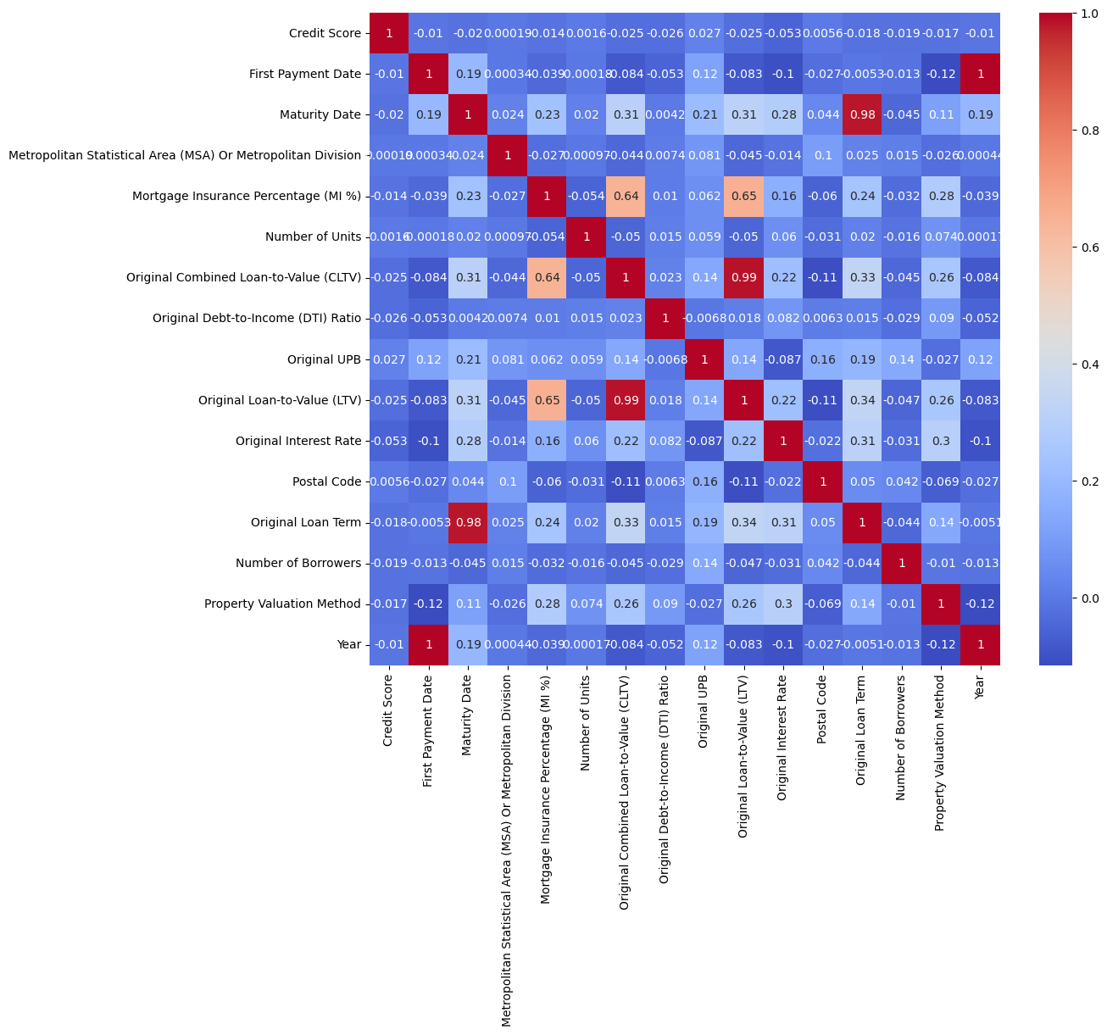

Slide 4
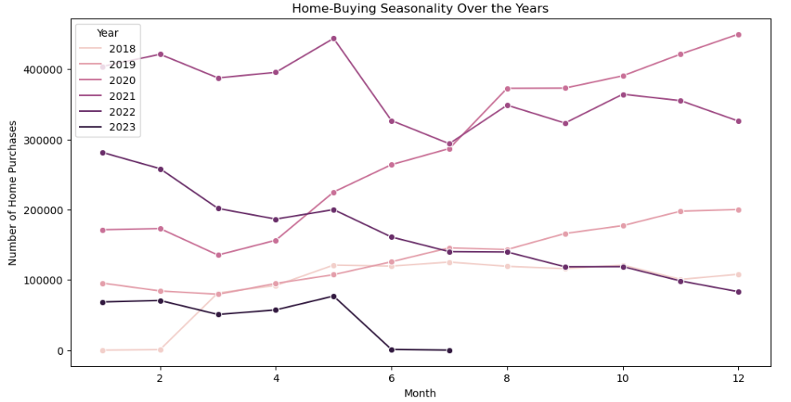
Home Buying Seasonality
Spring surge: There is a clear peak in home buying activity in the spring months (March-May) for each year.
Summer slowdown: Activity dips in the summer months (June-August) for each year.
Gradual pick-up in fall: Activity starts to pick up again in the fall months (September-November) for each year, but it does not always reach the same level as the spring peak.
Winter lull: Activity is lowest in the winter months (December-February) for each year.

Slide 5
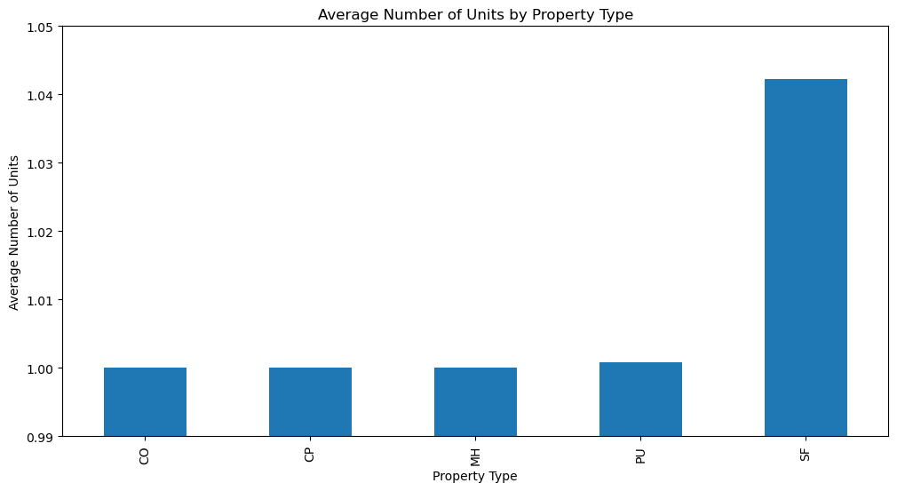
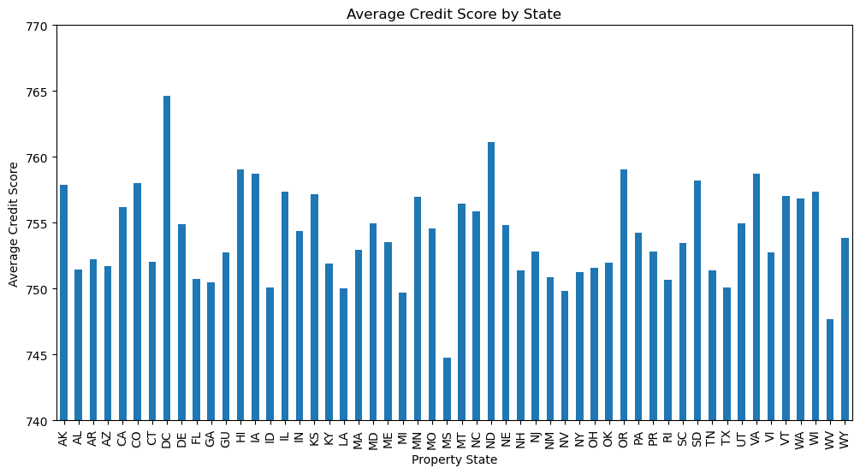
Analysis of Real Estate Trends: Credit quality , interest rate and property types
Average number of units per property :-
Single-family homes: 1.00 units
Townhomes: 1.02 units
Condominiums: 1.03 units
Apartments: 1.05 units
From the data given above it can be concluded that apartment has the highest average units per properties
DC has the highest average credit score , while MS having the lowest average credit score.
The average of credit scores among all the property states is come out 754 per state

Slide 6
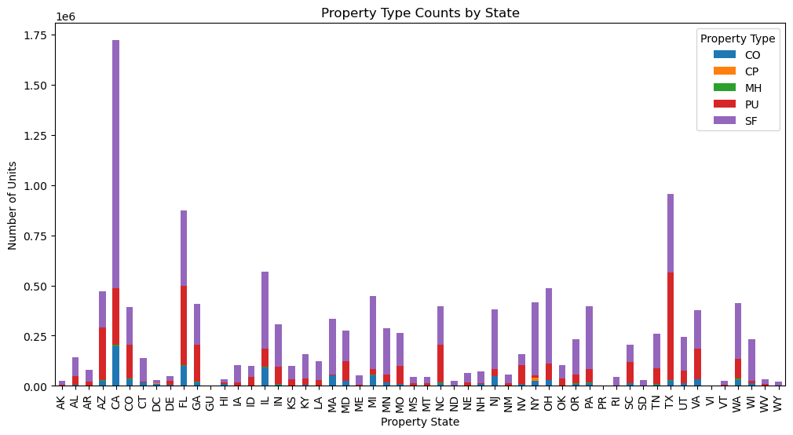
A huge variation between states for number of properties can be observed:-
TX and CA has a greater number of properties
While ME and VT with much less properties in number
The graph also shows the variation in the property type in different states:-
There are more SF properties in CA while TX has more PU type properties
A conclusion can be made out that CA has the greatest number of property unit among all the other states with SF being the most common property type

Slide 7
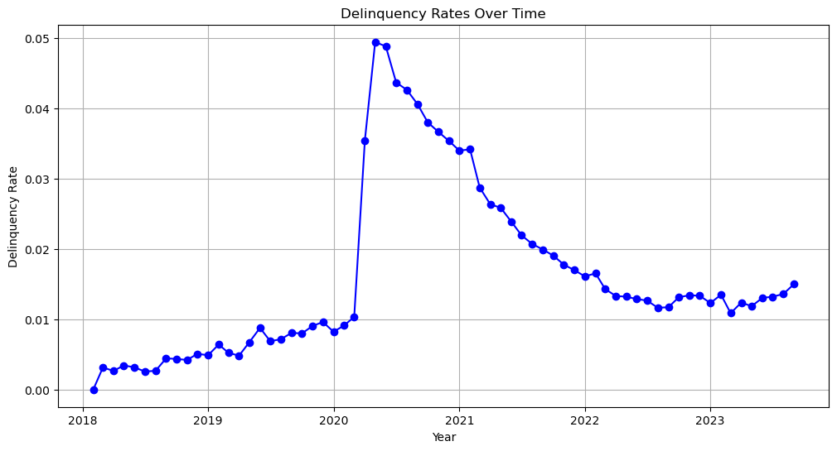
Trends in Delinquency rates
Delinquency rates had been very uncertain since 2018 till 2023
Steady growth between 2018 and 2020
Huge spike in 2020
Steady decline between 2020 and 2023
Seasonality variation in data with delinquency rates peaking in winter months and dipping in summer months
Reasons for spike in the delinquency rates
Rise in interest rates make it difficult to repay loans
Weakening of economy can lead to job losses and inclined salaries
Increase in debt levels make it difficult to manage debts and result In the increase of delinquency rates

Slide 8
Quality of lending and exposure for Freddie Mac.
Total Exposure by Credit Score Band:
Credit Score Band 0 has the highest total exposure with $306,071,574,000.
Credit Score Bands 1 to 8 show increasing total exposure.
Credit Score Band 9 has the lowest total exposure with $321,519,469,000.
Freddie Mac has a substantial total exposure in the mortgage market, ranging from $306 billion to $394 billion across different credit score bands.
Average Loss by Credit Score Band:
Credit Score Band 0 has the lowest average loss at $236,685.21.
Average loss generally increases as the credit score bands progress.
Credit Score Band 7 has a slight decrease in average loss compared to Credit Score Bands 5 and 6.
Credit Score Band 9 has a lower average loss compared to Bands 5 to 8.
The average loss is relatively low, ranging from $236,685 to $298,832 across credit score bands.
There is a general increasing trend in average loss as credit score bands progress, which aligns with conventional expectations in the lending industry.

Slide 9
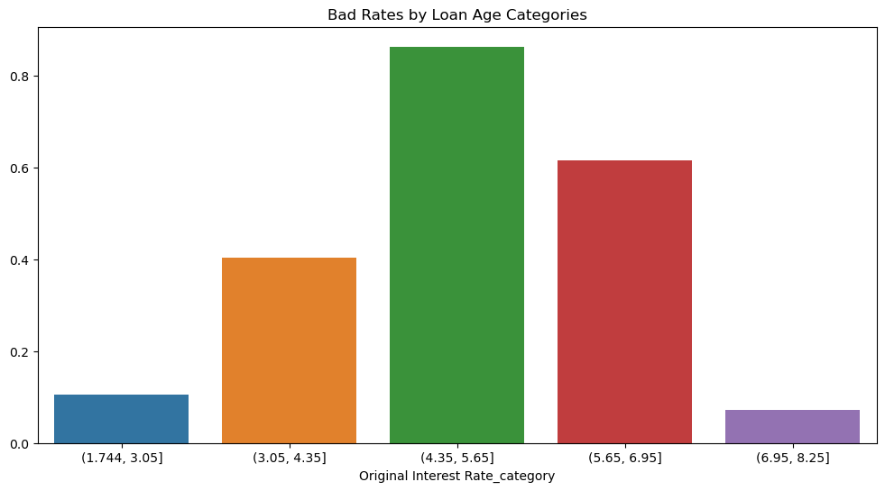
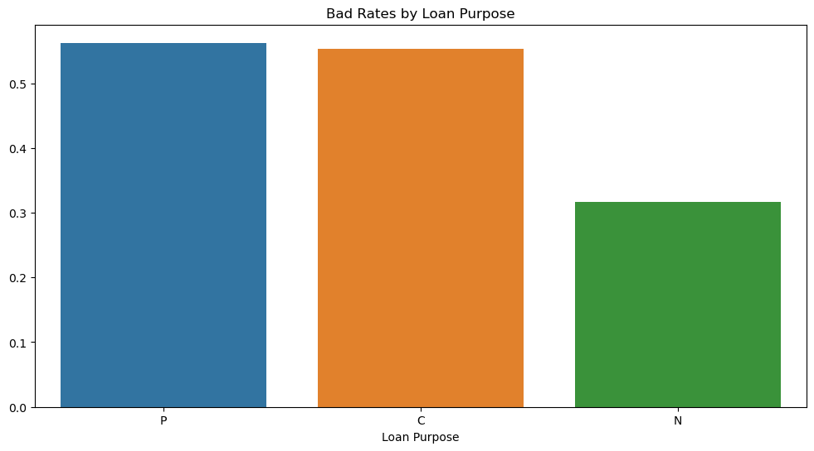
Risk Factor Variables
Loan Purpose:
Purchase (P): 56.23%
Cash-Out Refinance (C): 55.36%
No Cash-Out Refinance (N): 31.60%
Purchase and Cash-Out Refinance loans having higher bad rates compared to No Cash-Out Refinance loans.
Loan Age Categories:
(13.6, 27.2]: 52.13%
(40.8, 54.4]: 51.65%
(27.2, 40.8]: 50.74%
(-0.068, 13.6]: 46.89%
(54.4, 68.0]: 43.79%
The analysis suggests that younger loans (less than 13.6 months) and older loans (54.4 to 68.0 months) tend to have lower bad rates compared to loans in other age categories.
Original Interest Rate Categories:
(4.35, 5.65]: 86.41%
(5.65, 6.95]: 61.65%
(3.05, 4.35]: 40.39%
(1.744, 3.05]: 10.52%
(6.95, 8.25]: 7.24%
Loans with higher original interest rates tend to have higher bad rates. For example, loans with an original interest rate between 4.35% and 5.65% have a significantly higher bad rate compared to lower-interest rate categories.

Slide 10

THANK YOU

